Slide 1


CSE Workshop NLP - Transformers
Satwik Ram Kodandaram
Ph.D. Student - Accessible Computing Lab / WS-DL Research Group

Slide 2
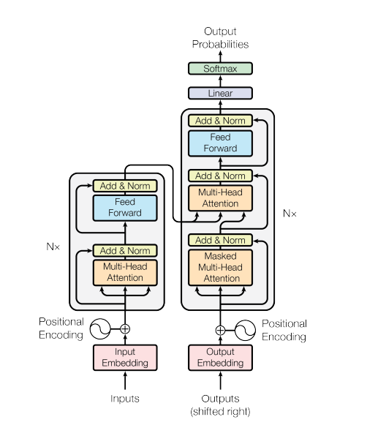
Transformers Architecture

Slide 3

A High-Level Look
Source: https://jalammar.github.io/illustrated-transformer/

Slide 4

A High-Level Look

Slide 5

Encoders Decoders

Slide 6
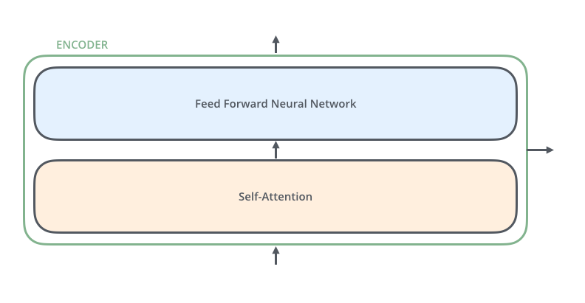
Encoders Decoders

Slide 7

Encoders Decoders

Slide 8
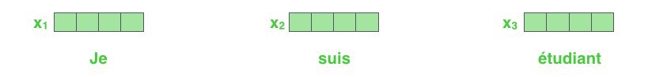
Bringing The Tensors Into The Picture
Each word is embedded into a vector of size 512. We'll represent those vectors with these simple boxes.

Slide 9
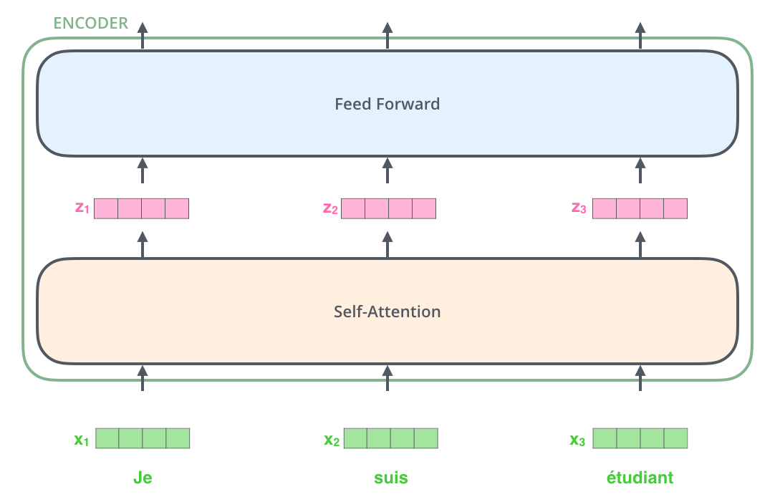
Bringing The Tensors Into The Picture

Slide 10
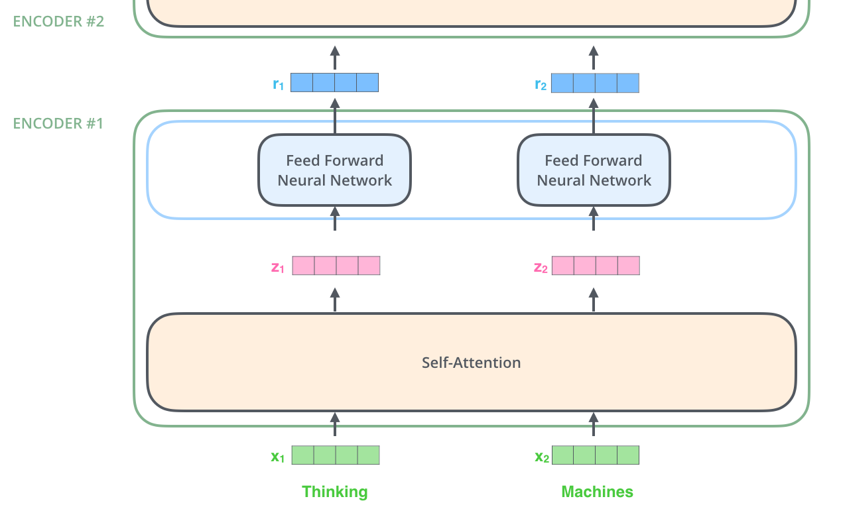
Now We’re Encoding!

Slide 11
Self-Attention at a High Level
“The animal didn't cross the street because it was too tired”
What does “it” in this sentence refer to? Is it referring to the street or to the animal? It’s a simple question to a human, but not as simple to an algorithm.
When the model is processing the word “it”, self-attention allows it to associate “it” with “animal”.

Slide 12

Self-Attention at a High Level
As we are encoding the word "it" in encoder #5 (the top encoder in the stack), part of the attention mechanism was focusing on "The Animal", and baked a part of its representation into the encoding of "it".

Slide 13
Self-Attention in Detail
The first step in calculating self-attention is to create three vectors from each of the encoder’s input vectors (in this case, the embedding of each word)
So, for each word, we create a Query vector, a Key vector, and a Value vector
Their dimensionality is 64
the embedding and encoder input/output vectors have dimensionality of 512

Slide 14

Self-Attention in Detail
Multiplying x1 by the WQ weight matrix produces q1, the "query" vector associated with that word. We end up creating a "query", a "key", and a "value" projection of each word in the input sentence.

Slide 15
What are the “query”, “key”, and “value” vectors?
The second step in calculating self-attention is to calculate a score.
Say we’re calculating the self-attention for the first word in this example, “Thinking”
The score determines how much focus to place on other parts of the input sentence as we encode a word at a certain position
Score = dot product of the query vector with the key vector
Self-attention for the word in position #1, the first score would be the dot product of q1 and k1.

Slide 16
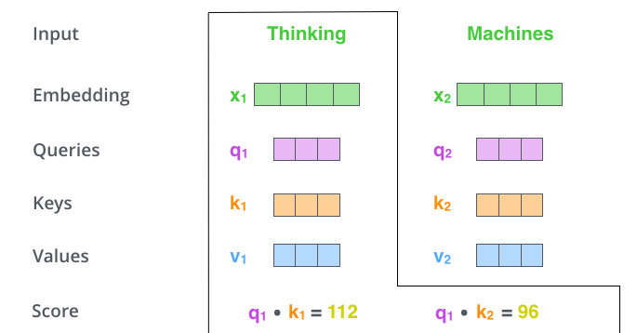
Self-Attention Score

Slide 17
Self-Attention Score
The third and fourth steps are to divide the scores by 8
Square root of the dimension of the key vectors used in the paper – 64
There could be other possible values here, but this is the default), then pass the result through a softmax operation
Softmax normalizes the scores so they’re all positive and add up to 1

Slide 18
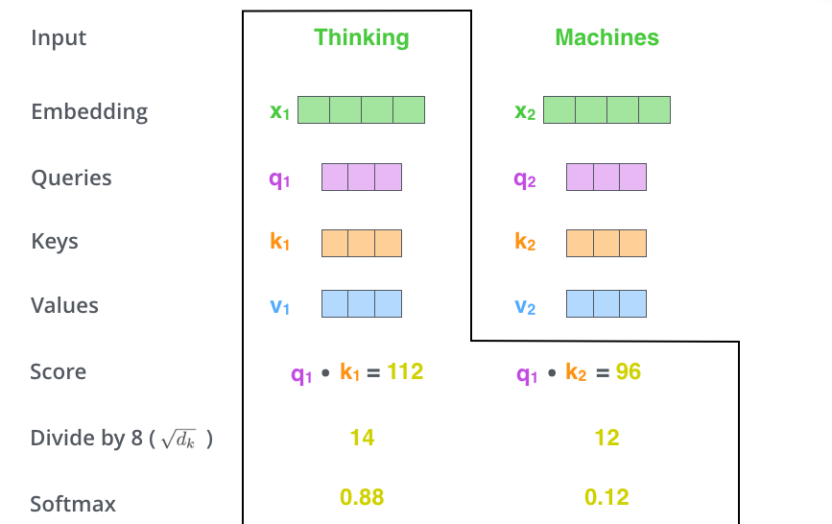
Self Attention Score

Slide 19
Self-Attention Score
This softmax score determines how much each word will be expressed at this position
The fifth step is to multiply each value vector by the softmax score (in preparation to sum them up)
The sixth step is to sum up the weighted value vectors. This produces the output of the self-attention layer at this position (for the first word).

Slide 20

Self-Attention Score

Slide 21
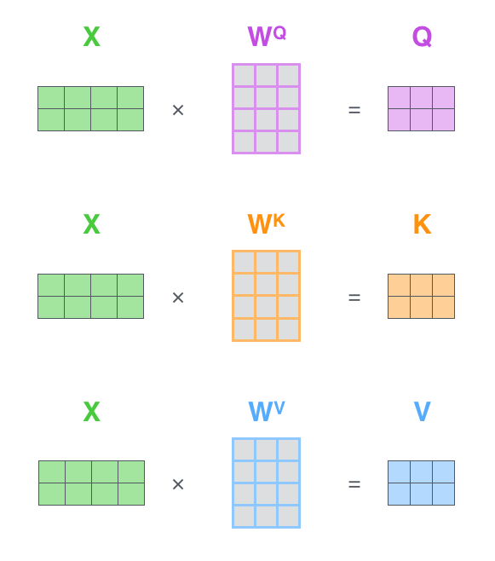
Matrix Calculation of Self-Attention
Every row in the X matrix corresponds to a word in the input sentence. We again see the difference in size of the embedding vector (512, or 4 boxes in the figure), and the q/k/v vectors (64, or 3 boxes in the figure)

Slide 22

Matrix Calculation of Self-Attention

Slide 23
The Beast With Many Heads
The paper further refined the self-attention layer by adding a mechanism called “multi-headed” attention
It expands the model’s ability to focus on different positions
It gives the attention layer multiple “representation subspaces”
with multi-headed attention we have not only one, but multiple sets of Query/Key/Value weight matrices
Transformer uses eight attention heads, so we end up with eight sets for each encoder/decoder

Slide 24
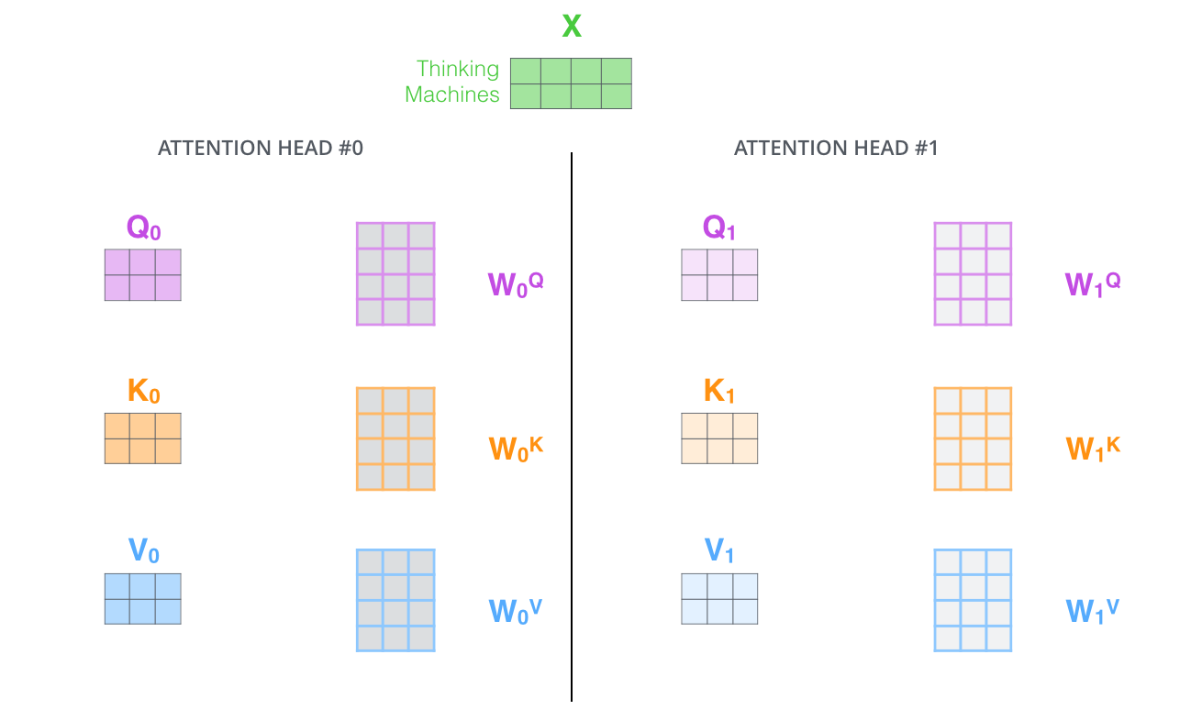
Multi-headed Attention

Slide 25
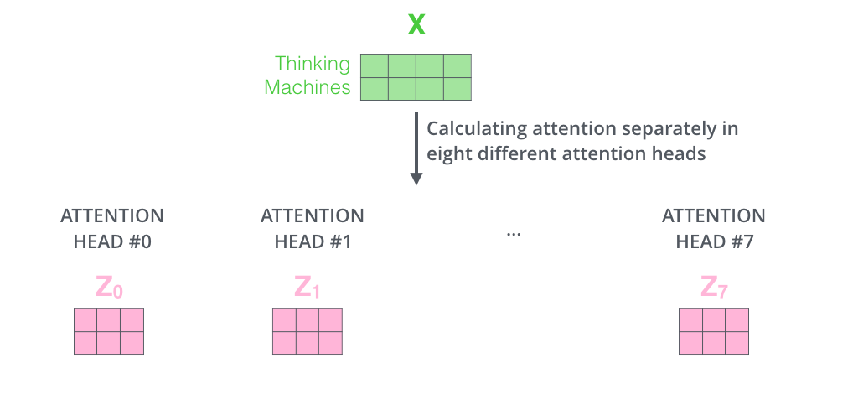
Multi-headed Attention

Slide 26
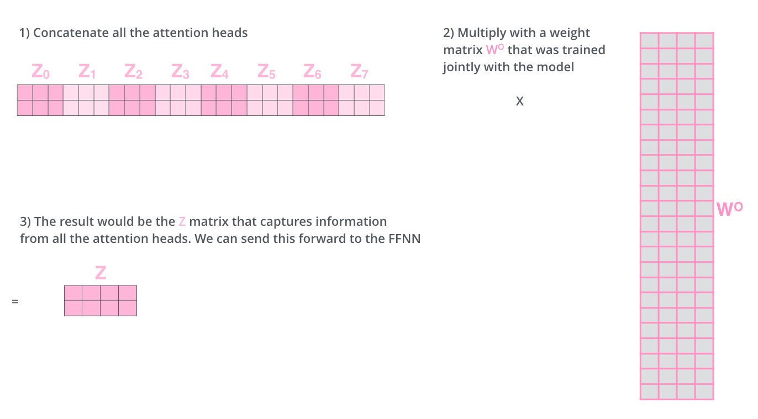
Multi-headed Attention

Slide 27

Multi-headed Attention

Slide 28
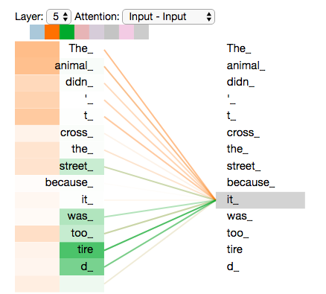
Multi-headed Attention

Slide 29
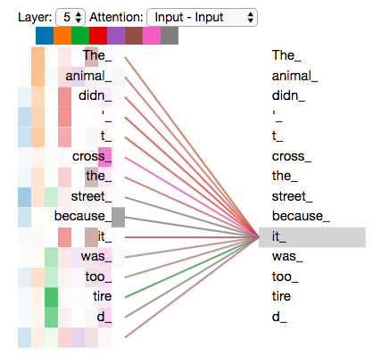
Multi-headed Attention

Slide 30
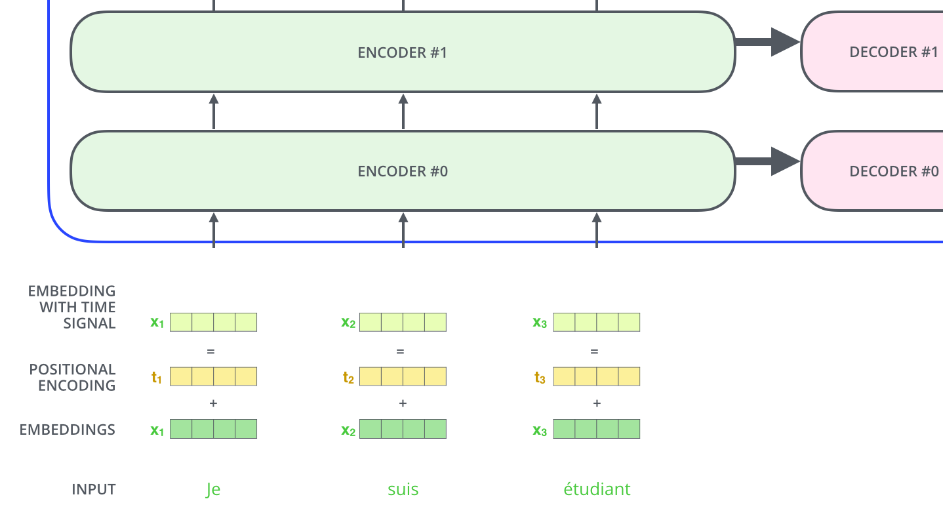
Representing The Order of The Sequence Using Positional Encoding

Slide 31
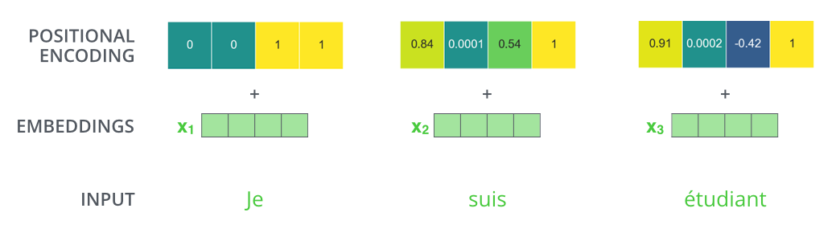
Representing The Order of The Sequence Using Positional Encoding

Slide 32
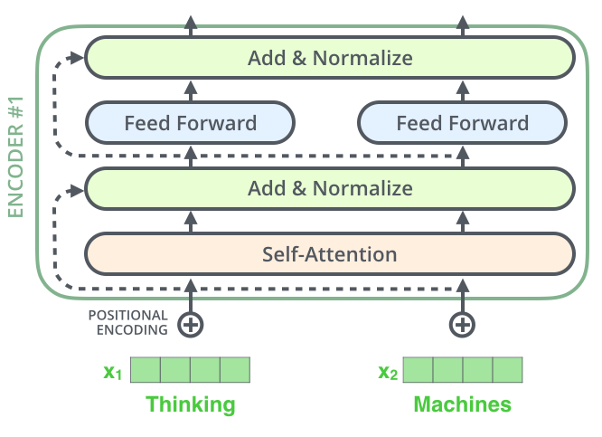
The Residuals

Slide 33

The Residuals

Slide 34

The Residuals

Slide 35

The Decoder Side

Slide 36
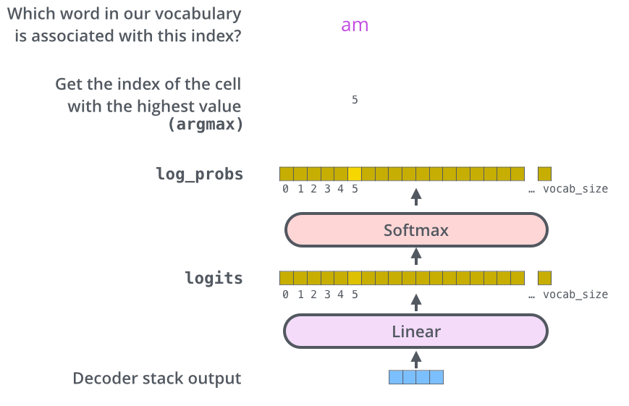
The Decoder Side

Slide 37
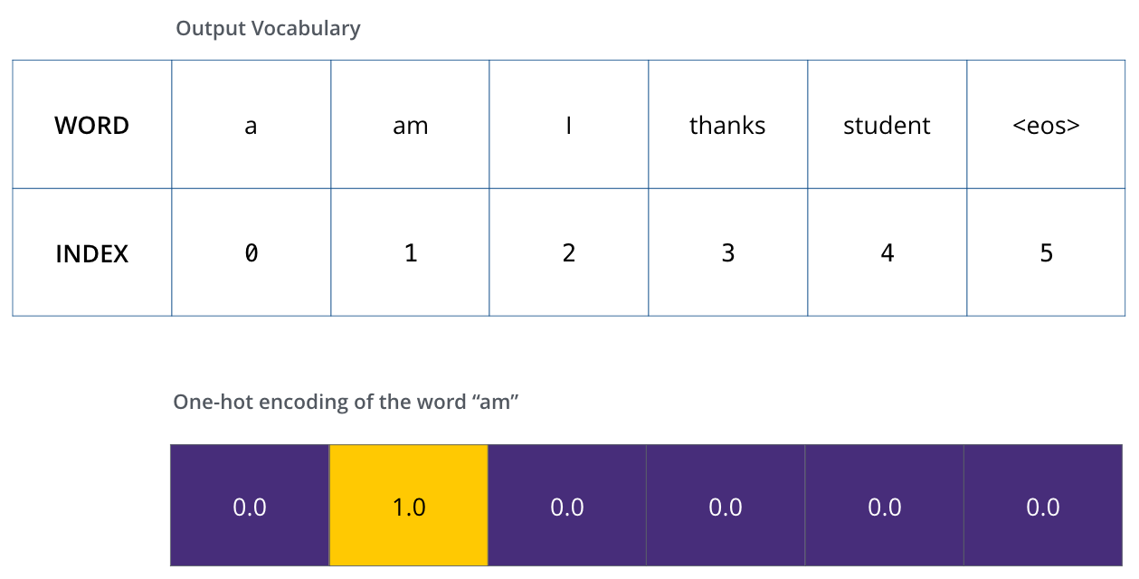
The Decoder Side

Slide 38
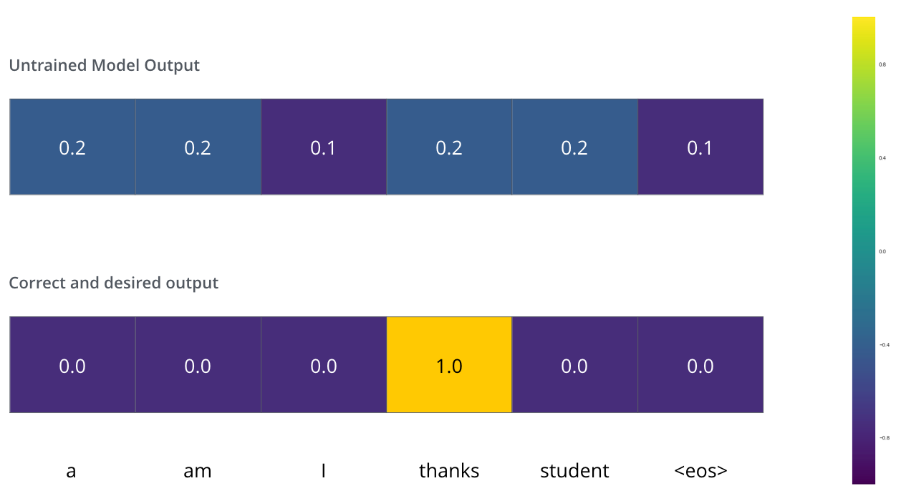
The Decoder Side
Since the model's parameters (weights) are all initialized randomly, the (untrained) model produces a probability distribution with arbitrary values for each cell/word. We can compare it with the actual output, then tweak all the model's weights using backpropagation to make the output closer to the desired output.

Slide 39
The Final Linear and Softmax Layer

Slide 40
Transformers Architecture - Recap

Slide 41
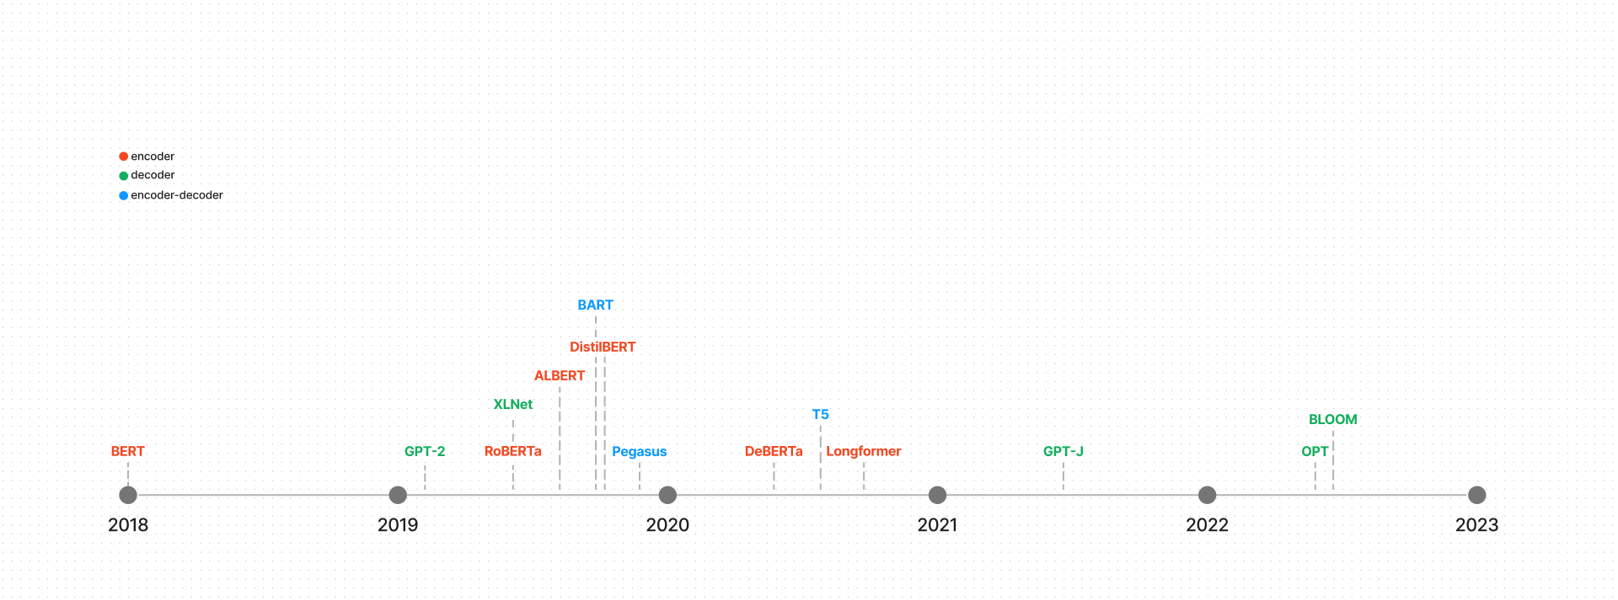
Transformers model timeline - NLP
Source: https://huggingface.co/docs/transformers/model_summary

Slide 42
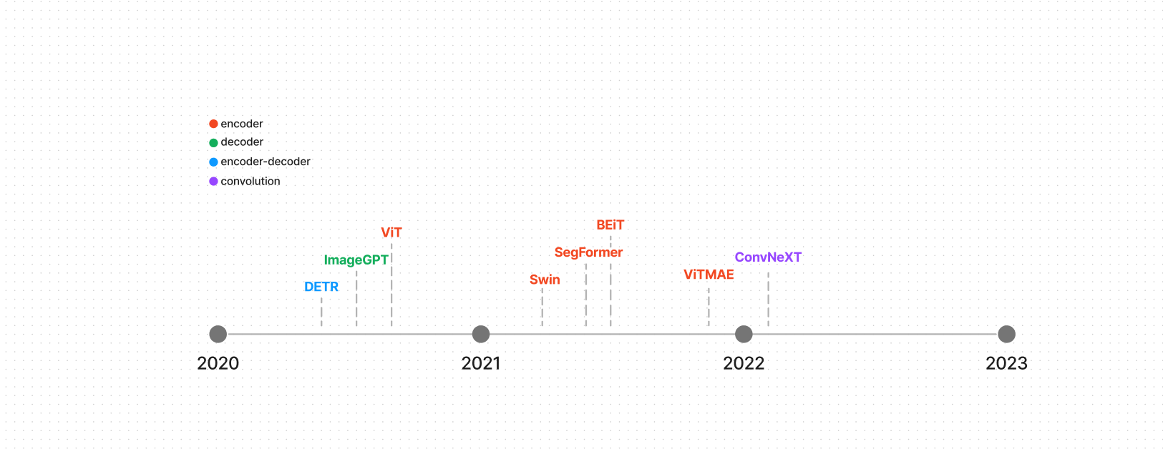
Transformers model timeline – CV
Source: https://huggingface.co/docs/transformers/model_summary

